Slide 1
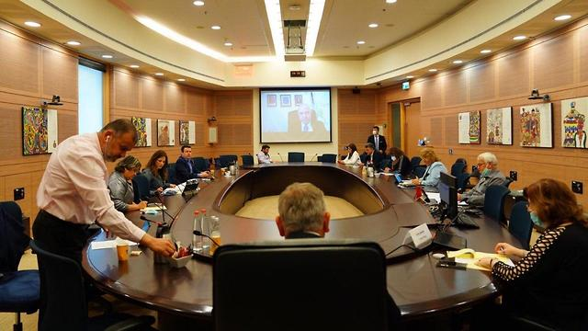
Knesset Committees Gender Bias App HLD
Created By:
Mohammad Ghanem
Mohammad Amer

Slide 2
Project Goal
Our goal in this project is to check equality/inequality in the Knesset Committees.
Since there is a serious social struggle with freedom of speech of women in many fields in the community, we want to see if the Knesset gives women the same space to speak as it gives the men.

Slide 3
Strategy
In our project we are dealing with big messy data, our mission was to go over all that data and convert it to small smart data.
We worked in a generic way and divided logical components of the project (like extracting algorithms and so) which will help us expand our project in the future for further research and easily handle faults and bugs

Slide 4
Working Plan
We divided our work into several tasks which contains:
Implementing the infrastructure of the project
Implementing Objects and classes that will be used in the project
Implementing the algorithm to convert files
Implementing the algorithm to extract Knesset members details
Implementing the algorithm for extracting needed committees details (was divided to sub-tasks and implemented one by the other)
Implementing the procedures that produces our final results (the csv file)
Implementing the Gender Bias App
Using the extracted information and produce visuals and supplying the client with an API to reach the resources.

Slide 5
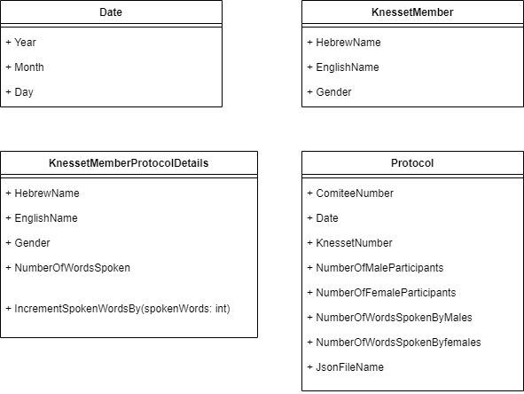
Objects Used Along The Project

Slide 6
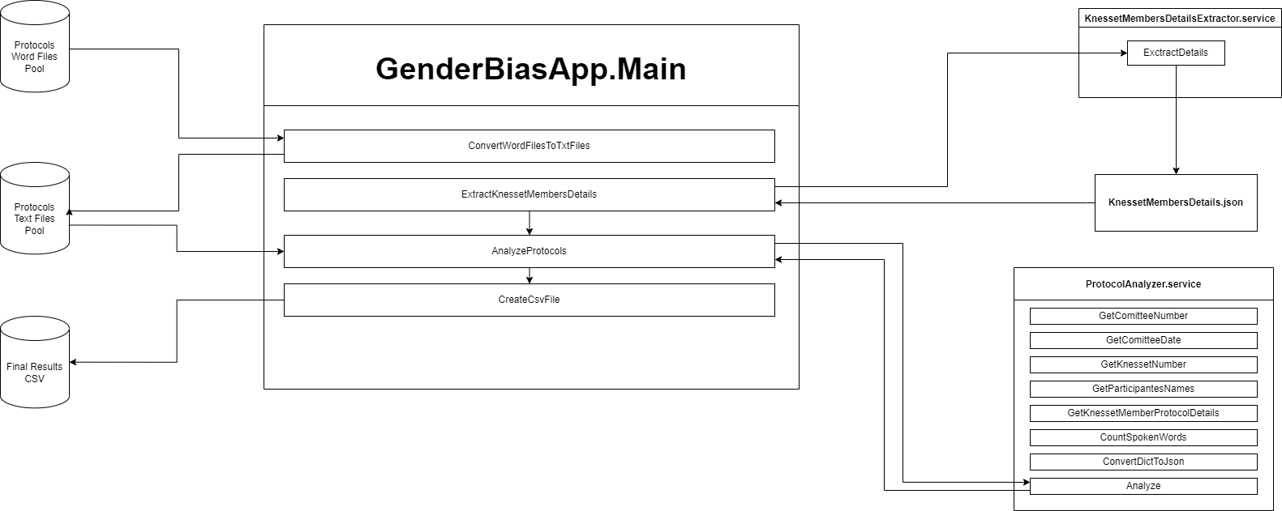
Gender Bias App – High Level

Slide 7
Gender Bias App – High Level – Code Demo
Source code demo\review

Slide 8
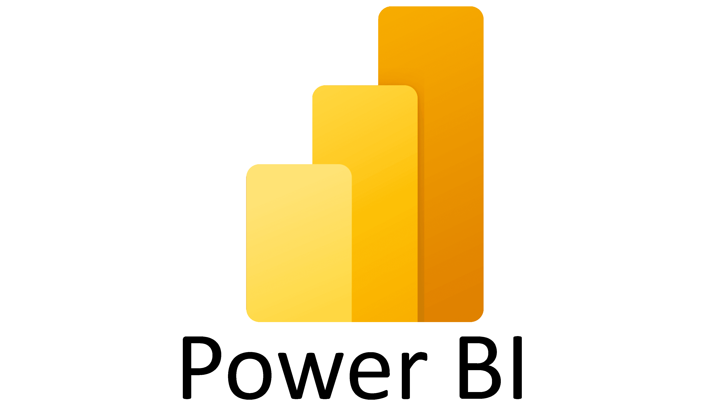

Gender Bias App – High Level – Visuals & API

Slide 9
Visuals & API - DEMO
In the Power BI portal

Slide 10

Thank You For Listening!

